Slide 1
SQI_{SIGN}
Isogeny-Based Digital Signature Scheme
Final Presentation
CS381/780 – Post Quantum Cryptography
Dr. Delaram Kahrobaei
Queens College, Fall 2024

Slide 2
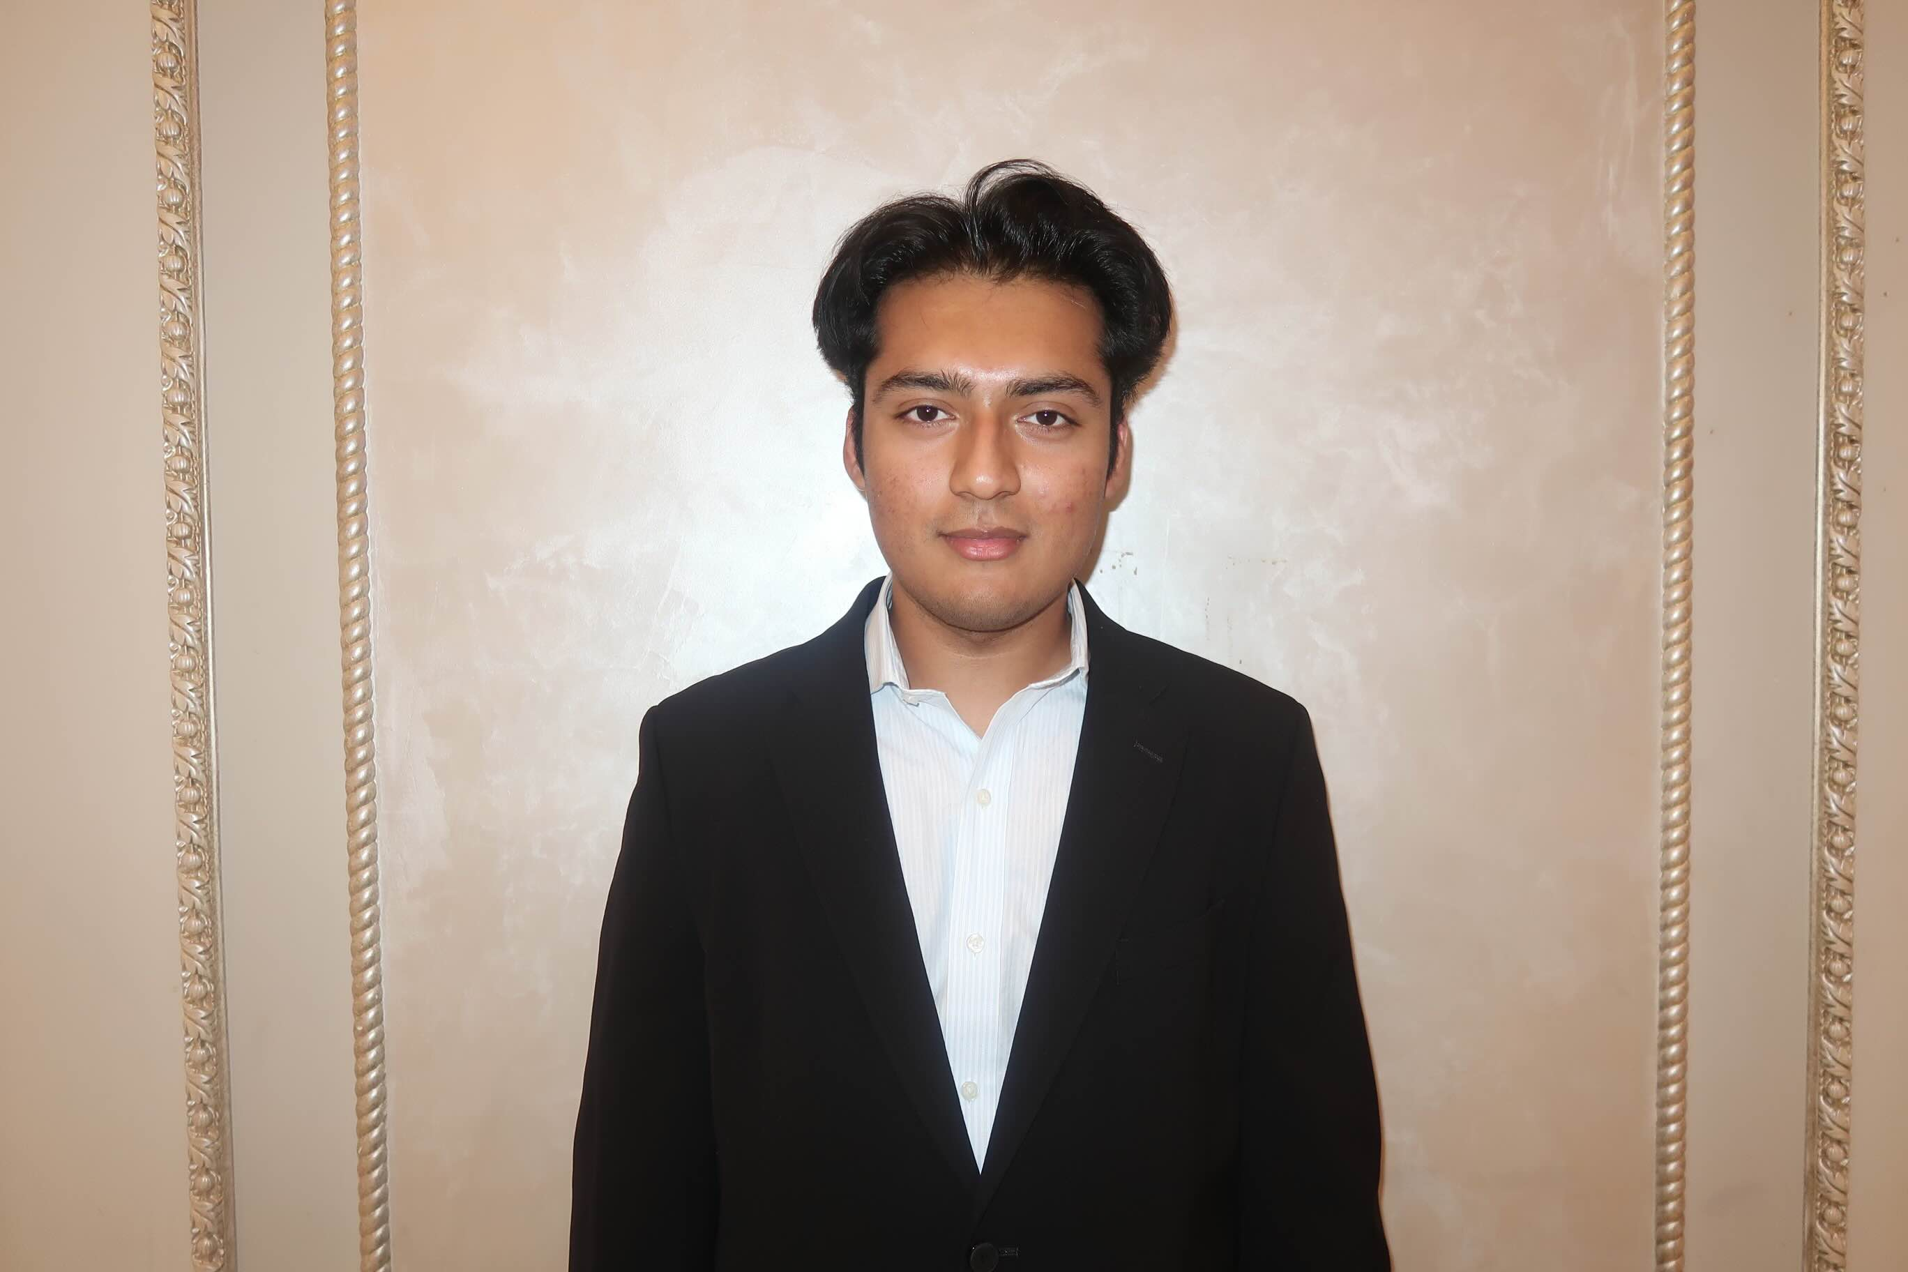

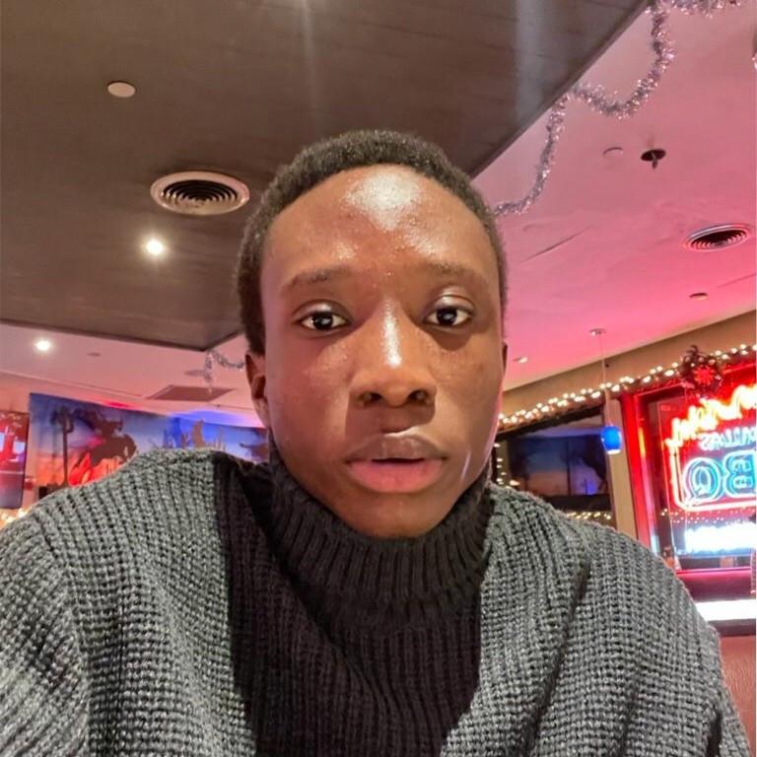


Abdul Mutallif
Osasere Imade
Suresh Yhap
Ajiya Shrestha
Matthew Withee

Slide 3
Chapter 2.6
Converting between ideals and isogenies

Slide 4
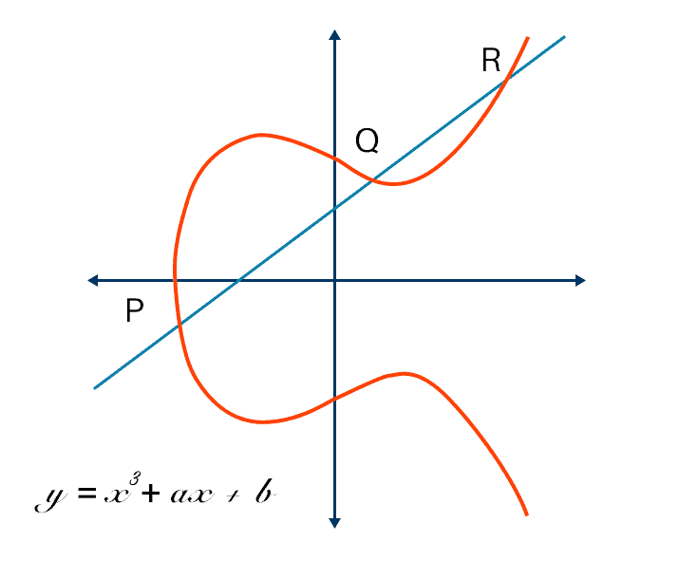
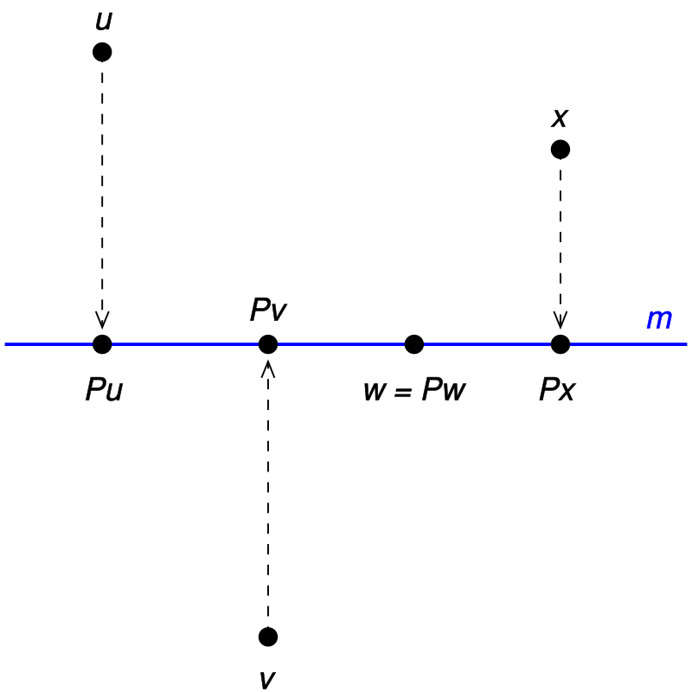
The Correspondence Between Elliptic Curve and Endomorphism
Elliptic Curve
Endomorphism

Slide 5
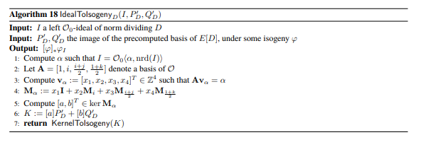
Converting Ideals to Isogenies with Kernels

Slide 6

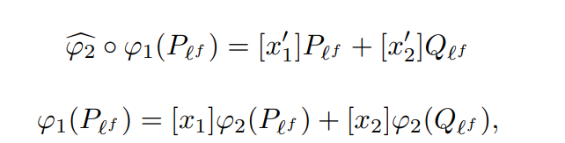
Compression and Endomorphism Evaluation
Same equation, but the second one is easier to compute

Slide 7
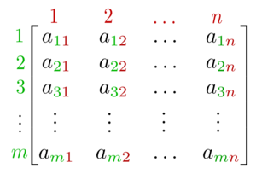
Decomposition
Geometric representation of an isogeny (elliptic curve)
Algebraic representation of the ideal corresponding to the isogeny (matrix)

Slide 8
Chapter 3 - Signature

Slide 9
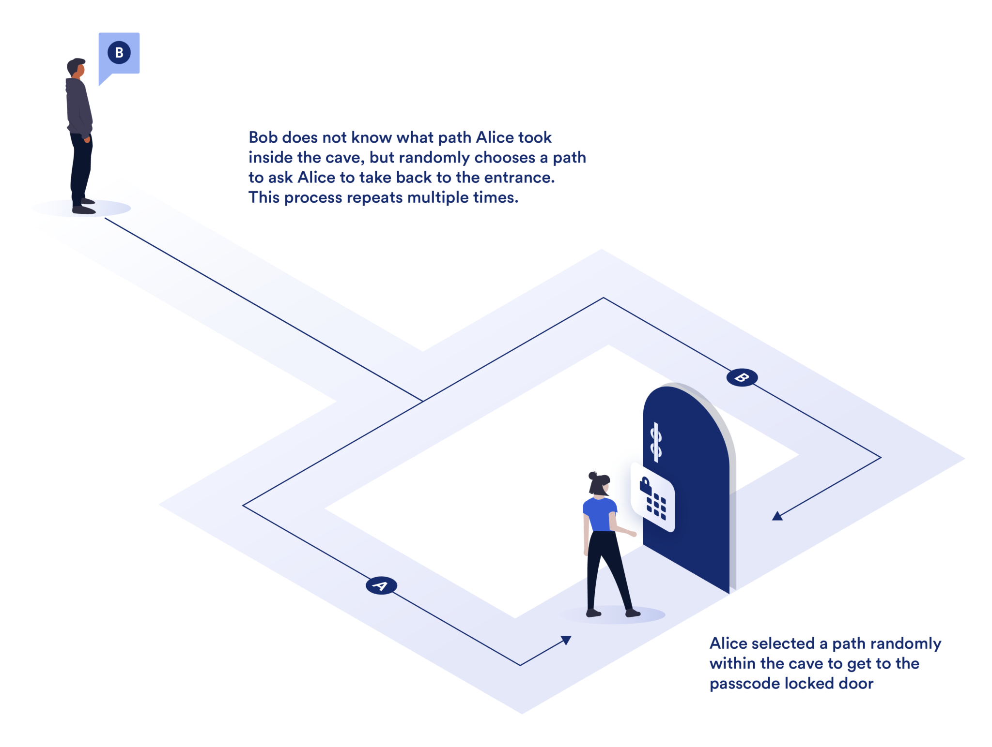
Section 3.1 - Σ-protocols and the Fiat-Shamir Heuristic
Interactive Proof of Knowledge
Zero-knowledge

Slide 10


Section 3.3 - Key Generation
SQIsign.KeyGen Algorithm
Then a secret ideal is computed: I_{secret} = 𝑂₀ (γ(𝑎 + 𝑖)) + 𝑂₀(𝐷_{secret})
Connecting quaternion is found and used to find a connecting ideal

Slide 11
Section 3.3 - Key Generation
B_{0, T} is a basis for E₀[T], the T-torsion subgroup of E₀.
φ_{secret} maps B_{0, T} to the basis for T-Torsion subgroup of E_{A}.

Slide 12


Section 3.3 - Key Generation
P and Q are basis points.
The secret isogeny is applied to Q.
The signing key (the knowledge) is the connecting quaternion, basis of T-torsion subgroup of E_{A}, and mapped basis point Q

Slide 13
Signing
The signing ensures secure digital signatures. It is divided into three main stages: Commitment Phase, Challenge Phase, and Response Phase.

Slide 14
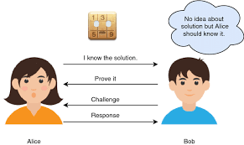
Three interactive phases
Public key: E_{A}
Private key (knowledge): End(E_{A})
1) Commitment: Prover randomly generates (E₁, End(E₁)). Sends E₁ to verifier.
2) Challenge: Verifier randomly generates φ_{chall} : E₁ → E₂ and sends φ_{chall} to prover.
3) Response: Prover uses End(E₁) and φ_{chall} to compute End(E₂). Then uses this and its knowledge to compute φ_{resp} : E_{A} → E₂. Sends this to Verifier
Verifier who has the public key and E₂ can easily check if φ_{resp} is a correct isogeny

Slide 15
Verification
The verification algorithm confirms the validity of a digital signature by ensuring it corresponds to the given message and public key.

Slide 16
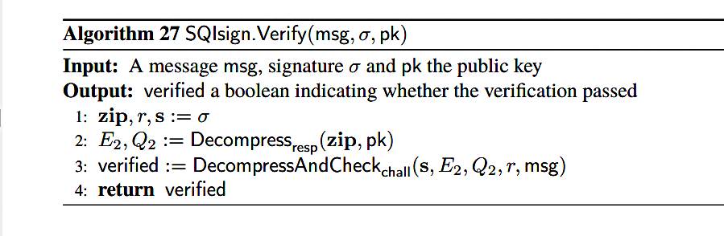
Verification
Inputs: Msg is the original message, σ is the Signature which consists of compressed response data (zip), value (r), and parameters (s) and pk is the Public key.
Outputs: A Boolean indicating whether the signature is valid or not.
Purpose: This algorithm ensures message authenticity by validating the signature against the public key and the original message

Slide 17
Optimizing Security and Efficiency in SQIsign Parameter Selection, Performance and Implementation.

Slide 18
Introduction
SQI_{SIGN} aims to provide efficient and secure digital signatures it is designed to work with stringent security set by NIST (National Institute of Standards and Technology).
Parameter choices plays a huge role in achieving efficient cryptographic schemes. By carefully choosing mathematical parameters, we can ensure both performance and security

Slide 19

Parameter Requirements
Parameter Requirements refer to the specific set of mathematical parameters chosen to optimize efficiency and security in the signature scheme. The choice of parameters affects efficiency and not security
The efficiency of SQI_{SIGN} largely depends on choosing a prime $p$of suitable size such that $p^{2} −1$contains many smooth prime factors. Smooth primes because this allows faster computation of isogenies .

Slide 20

Parameters…
There are five parameters recommended for security parameter $λ$; they include:
Prime sizes of $\log_{2}{p ≈2λ}$
The degree D_{com} of the commitment isogeny $φ$_{com} of size approximately $2^{2λ}≈p$
The degree D_{chall} of the challenge isogeny $φ$_{chall} of approximately $2^{2λ}≈p^{\frac{1}{2}}$
The degree $l^{e}$of the signature isogeny$φ$_{resp} of size approximately $p^{\frac{15}{4}}$
The choice of our parameter prioritizes fast verification, while maintaining reasonable signing performance.

Slide 21

Parameter Search Method
The Sieve and Boost Method
This technique finds prime that meet the smoothness requirements.
We search for primes of the form $p=2{\left(2f^{′}3^{g^{′}}x\right)}^{n}−1$for a smooth number $x$ and for different values of $f^{′}, g^{′}$such that $2^{nf^{′}}.3^{ng^{′}} ≥ \sqrt{p }$ to ensure $φ$_{chall} can be computed as a chain of 2-isogenies and 3-isogenies.
Plainly, the sieve and boost method filters out candidates by looking at smooth numbers in the range, and then we compute potential prime numbers with various combinations of $f^{′}, g^{′}.$This helps us generate prime numbers that work for different SQIsign security level.

Slide 22
SQIsign Library modules
These models perform different cryptographic and mathematical calculations.
Elliptic curve and isogeny computation: This handles calculations related to elliptic curve, essential for isogenies used in signing.
KLPT Algorithm: implementation of the KLPT algorithm which maps certain ideals to isogenies
Id2iso: implementation of ideal to isogeny computation

Slide 23
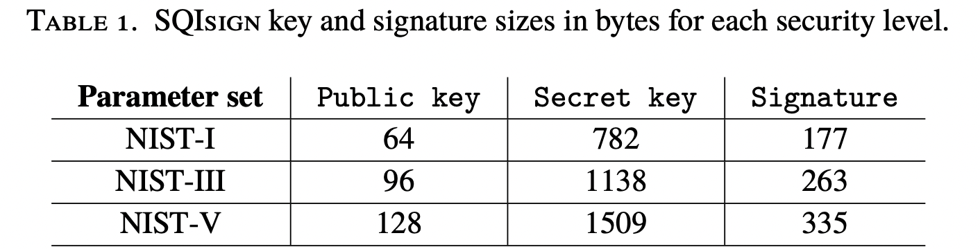
Key and Signature Sizes
Key and signature sizes directly impact storage, transfer speed, and the scheme’s security.
A larger key size strengthens the scheme’s resistance to attacks but increases storage size.
Small signatures reduces the data we need to transmit.

Slide 24
Key Constants in SQISign
There are various constants is KeySign that ensure efficient and reliable key generation. Some of these SQISign with their constants are as follows:
FullRepresentInteger constant is given as KLPT_repress_num_gamma_trial this defines the maximum number of attempts made in the algorithm FullRepresentInteger.
KeyGenKLPT constant is given as KLPT_Keygen_number_strong _approx where the number of vectors tried for the strong approximation step inside the KeyGenKLPT algorithm.

Slide 25
Chapter 8/9 – Assumptions, Security, and Attacks

Slide 26
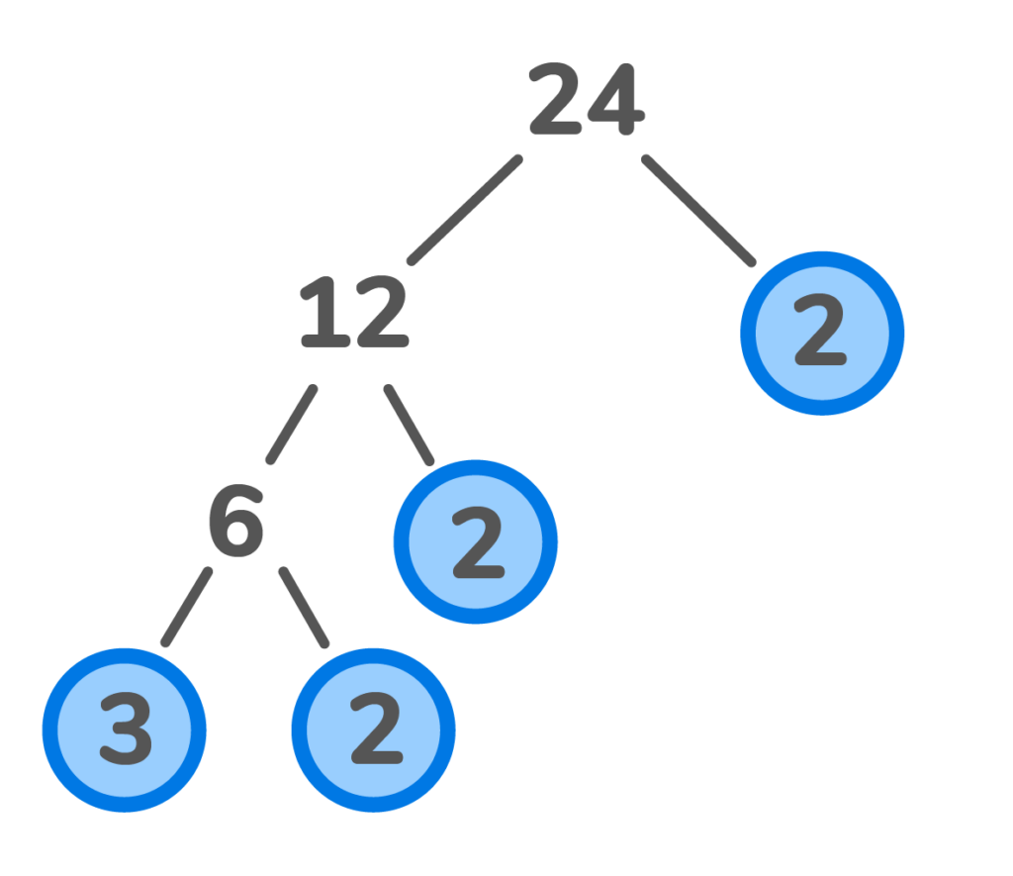
Assumptions
Where It’s Used
SQI_{SIGN} requires several important numbers be large prime numbers, importantly the modulus p when constructing the field F_{p}
Random Lattices
SQI_{SIGN}
Primality
Primality
Ideal Size
Why It’s Needed
Quadratic Residuosity
Conditions
Ensures the elliptic curve structure is preserved and simplifies the process of working with them. Also improves security as factorization can’t be used to break down the curves

Slide 27
Assumptions
Where It’s Used
SQISIGN uses quadratic residues to ensure that points lie on a curve, while non-residues are used in the generation of the isogeny path.
Random Lattices
SQI_{SIGN}
Primality
Ideal Size
Why It’s Needed
Quadratic Residuosity
Conditions
Quadratic Residuosity
Conditions
There is an extra layer of security as attackers shouldn’t be able to distinguish between residues and non-residues
Quadratic Residue - a number that can be expressed as the square of an integer within a given modular system

Slide 28
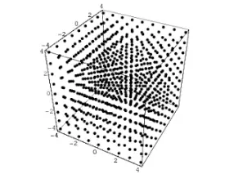
Assumptions
Where It’s Used
Random lattices are importantly used in key generation, signatures, and some transformations
Random Lattices
Random Lattices
SQI_{SIGN}
Primality
Ideal Size
Why It’s Needed
Quadratic Residuosity
Conditions
The randomness of the lattices in SQI_{SIGN} ensures they can’t be reconstructed

Slide 29
Assumptions
Where It’s Used
Random Lattices
SQI_{SIGN} uses ideals to compute isogenies, the basis of the digital signature
SQI_{SIGN}
Primality
Ideal Size
Ideal Size
Why It’s Needed
Quadratic Residuosity
Conditions
If the ideals are too small, the security of the scheme is compromised. If they are too large, the computation will be too resource-intensive

Slide 30
Security Reductions
These are properties that the ∑-protocol should satisfy:
Correctness
Special Soundness
Weak Honest-Verifier Zero-Knowledge
IMP-PA Security
Digital Signature Security with Fiat-Shamir

Slide 31
Security Reductions
Correctness
V(x, comm, chall, resp) = 1
Variables:
x: public key
w: private key
com ←P1(x,w): commitment
chall ←{0,1}^{λ} : random challenge from verifier
resp ← P2(chall): response to challenge from prover
These are properties that the ∑-protocol should satisfy:
Correctness
Special Soundness
Weak Honest-Verifier Zero-Knowledge
IMP-PA Security
Digital Signature Security with Fiat-Shamir
✓
✓
✓
✓
✓

Slide 32
Security Reductions
Correctness
V(x, comm, chall, resp) = 1
Variables:
x: public key
w: private key
com ←P1(x,w): commitment
chall ←{0,1}^{λ} : random challenge from verifier
resp ← P2(chall): response to challenge from prover
Special Soundness
The property that prevents cheating. If someone can produce two distinct correct responses, they must know the secret key.
In SQI_{SIGN} soundness relies on the difficulty of computing the endomorphism ring
These are properties that the ∑-protocol should satisfy:
Correctness
Special Soundness
Weak Honest-Verifier Zero-Knowledge
IMP-PA Security
Digital Signature Security with Fiat-Shamir
✓
✓
✓
✓
✓

Slide 33
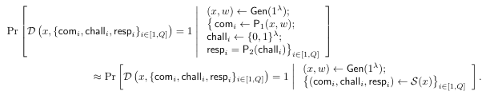
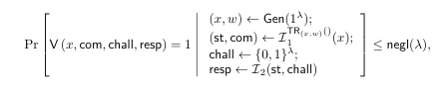
Security Reductions
Correctness
V(x, comm, chall, resp) = 1
Variables:
x: public key
w: private key
com ←P1(x,w): commitment
chall ←{0,1}^{λ} : random challenge from verifier
resp ← P2(chall): response to challenge from prover
Weak Honest-Verifier Zero-Knowledge
The verifier doesn’t gain any information about the private key during the verification process. A scheme could produce other results that are indistinguishable from real results
This is not explicitly handled in SQI_{SIGN} in terms of producing “fake” results, but the scheme handles with the multiple isogenies.
Special Soundness
The property that prevents cheating. If someone can produce two distinct correct responses, they must know the secret key.
In SQI_{SIGN} soundness relies on the difficulty of computing the endomorphism ring
These are properties that the ∑-protocol should satisfy:
Correctness
Special Soundness
Weak Honest-Verifier Zero-Knowledge
IMP-PA Security
Digital Signature Security with Fiat-Shamir
✓
✓
✓
✓
✓

Slide 34
Security Reductions
IMP-PA Security
(Impersonation Under Passive Attack)
Theorem: Any ∑-protocol that satisfies special soundness and wHVZK also satisfies IMP-PA
IMP-PA says that even if someone is strictly observing the protocol without interacting, they are still unable to obtain information about the secret key
Correctness
V(x, comm, chall, resp) = 1
Variables:
x: public key
w: private key
com ←P1(x,w): commitment
chall ←{0,1}^{λ} : random challenge from verifier
resp ← P2(chall): response to challenge from prover
Weak Honest-Verifier Zero-Knowledge
The verifier doesn’t gain any information about the private key during the verification process. A scheme could produce other results that are indistinguishable from real results
This is not explicitly handled in SQI_{SIGN} in terms of producing “fake” results, but the scheme handles with the multiple isogenies.
Special Soundness
The property that prevents cheating. If someone can produce two distinct correct responses, they must know the secret key.
In SQI_{SIGN} soundness relies on the difficulty of computing the endomorphism ring
These are properties that the ∑-protocol should satisfy:
Correctness
Special Soundness
Weak Honest-Verifier Zero-Knowledge
IMP-PA Security
Digital Signature Security with Fiat-Shamir
✓
✓
✓
✓
✓

Slide 35

Security Reductions
Correctness
V(x, comm, chall, resp) = 1
Variables:
x: public key
w: private key
com ←P1(x,w): commitment
chall ←{0,1}^{λ} : random challenge from verifier
resp ← P2(chall): response to challenge from prover
Special Soundness
The property that prevents cheating. If someone can produce two distinct correct responses, they must know the secret key.
In SQI_{SIGN} soundness relies on the difficulty of computing the endomorphism ring
Digital Signature Security with Fiat-Shamir
EUF-CMA: Existential unforgeability against chosen message attacks
Theorem: If a ∑-protocol satisfies IMP-PA, then that protocol after a Fiat-Shamir transformation also satisfies EUF-CMA
These are properties that the ∑-protocol should satisfy:
Correctness
Special Soundness
Weak Honest-Verifier Zero-Knowledge
IMP-PA Security
Digital Signature Security with Fiat-Shamir
✓
✓
✓
✓
✓

Slide 36
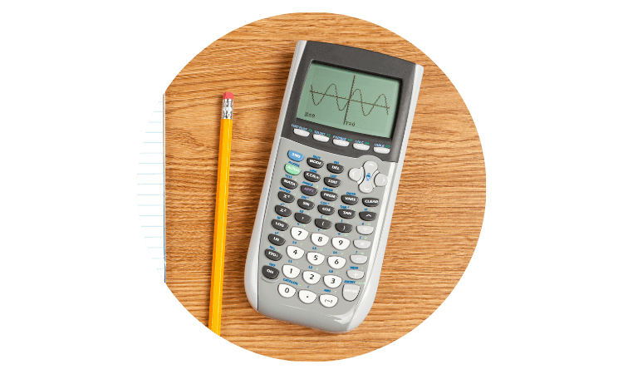



Resistance Against Known Attacks
Endomorphism Ring Computation
Key Recovery
Soundness/Forgery
Zero-Knowledge

Slide 37
Thank you!

